Slide 1
NORMALIZATION
Normal Forms Based on Primary Keys

Slide 2
Normalization: The process of decomposing unsatisfactory "bad" relations by breaking up their attributes into smaller relations
Normal form: Condition using keys and FDs of a relation to certify whether a relation schema is in a particular normal form

Slide 3
Normalization
The normalization process was first proposed by Codd 1972.
Normalization is a formal technique for analyzing a relation based on its primary key and the FDs between the attributes of that relation.
Normalization: The process of decomposing unsatisfactory "bad" relations by breaking up their attributes into smaller relations
Normal form: Condition using keys and FDs of a relation to certify whether a relation schema is in a particular normal form
Objectives of Normalization:
(1) minimizing redundancy and
(2) minimizing the insertion, deletion, and update anomalies

Slide 4
Normal Forms
The normalization process takes a relation schema through a series of tests to certify whether it satisfies a certain normal form.
The four most commonly used normal forms are:
First Normal Form (1NF)
Second Normal Form (2NF)
Third Normal Form (3NF)
Boyce-Codd Normal Form (BCNF)
Other Normal Forms:
Fourth Normal Form(4NF)
Fifth Normal Form(5NF)
Based on Functional Dependencies
Based on Multivalued Dependencies and Join Dependencies respectively

Slide 5
Contd..
Unsatisfactory relation schemas that do not meet certain conditions—the normal form tests—are decomposed into smaller relation schemas that meet the tests.
The normal form of a relation refers to the highest normal form condition that it meets, and hence indicates the degree to which it has been normalized.
Properties of Normal Forms:
The lossless join or non-additive join property, guarantees that the spurious tuple generation problem after decomposition.
The dependency preservation property, ensures that each functional dependency is represented in some individual relations resulting after decomposition.

Slide 6
Steps
To convert un-normalized table to a normalized one, you first convert it to INF, then to 2NF, then to 3NF and then to BCNF. In other words:
UNF → 1NF → 2NF → 3NF → BCNF

Slide 7
1. First Normal Form
If a relation contain composite or multi-valued attribute, it violates first normal form or a relation is in first normal form if it does not contain any composite or multi-valued attribute.
A relation is in first normal form if every attribute in that relation is singled valued attribute.
Attribute Domain does not change.
There is a unique name for every Attribute/Column.
The order in which data is stored does not matter.

Slide 8
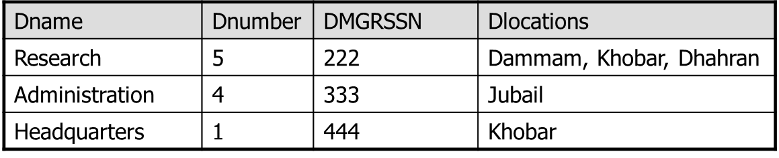
Unnormalized Form (UNF)
A table would be in unnormalized form if it contains some multi-valued attributes or repeating groups.
Example:

Slide 9
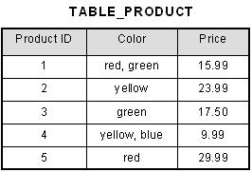
1st Normal Form Example

Slide 10
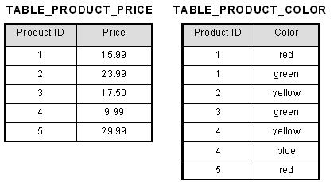

Slide 11
Second Normal Form (2NF)
Based on the concept of full functional dependency.
Full functional dependency indicates that if
A and B are attributes of a relation,
B is fully dependent on A if B is functionally dependent on A but not on any proper subset of A.
Example: In the last table {SSN, Pnumber} → Hours is a full dependency. (neither SSN → Hours nor Pnumber → hours hold)
A relation that is in 1NF and every non-primary-key attribute is fully functionally dependent on the primary key.

Slide 12
Example
EMP_PROJ
Social Security Number determines employee name:
SSN -> ENAME
Project number determines project name and location:
PNUMBER -> {PNAME, PLOCATION}
Employee SSN and project number determines the hours per week that the employee works on the project:
{SSN, PNUMBER} -> HOURS

Slide 13
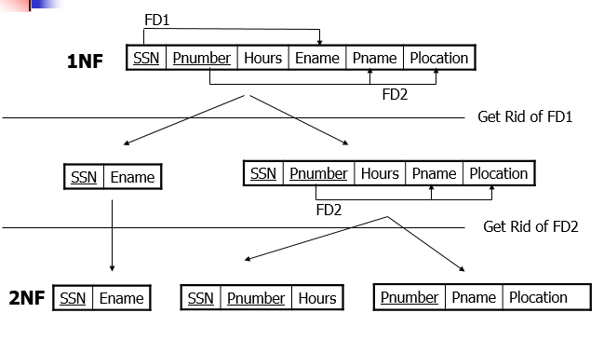
Example: 1NF to 2NF

Slide 14
To be in second normal form, a relation must be in first normal form and relation must not contain any partial dependency.
A relation is in 2NF if it has No Partial Dependency, i.e., no non-prime attribute (attributes which are not part of any candidate key) is dependent on any proper subset of any candidate key of the table.
Partial Dependency – If the proper subset of candidate key determines non-prime attribute, it is called partial dependency.

Slide 15
1NF to 2NF
If a primary key is a single attribute then the relation is already in 2NF.
In the case of composite key, the following steps are applied to convert to 2NF:
Identify the primary key for the 1NF
Identify the functional dependencies in the relation
If partial dependency exists on the primary key remove them by placing them in a new relation along with a copy of their determinant.

Slide 16
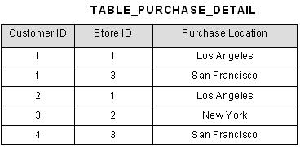
This table has a composite primary key [Customer ID, Store ID]. The non-key attribute is [Purchase Location]. In this case, [Purchase Location] only depends on [Store ID], which is only part of the primary key. Therefore, this table does not satisfy second normal form.

Slide 17
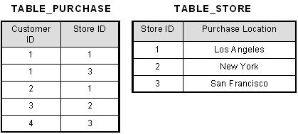
What we have done is to remove the partial functional dependency that we initially had. Now, in the table [TABLE_STORE], the column [Purchase Location] is fully dependent on the primary key of that table, which is [Store ID].

Slide 18
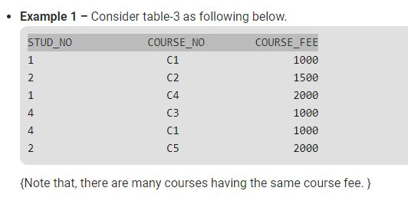
Convert the Relation in to 2NF

Slide 19
Given a relation R( A, B, C, D) and Functional Dependency set FD = { AB → CD, B → C }, determine whether the given R is in 2NF? If not convert it into 2 NF.

Slide 20
Let us calculate the closure of AB
AB + = ABCD (from the method we studied earlier)
Since the closure of AB contains all the attributes of R, hence AB is Candidate Key
Definition of 2NF: No non-prime attribute should be partially dependent on Candidate Key
Since R has 4 attributes: - A, B, C, D, and Candidate Key is AB, Therefore, prime attributes (part of candidate key) are A and B while a non-prime attribute are C and D
a) FD: AB → CD satisfies the definition of 2NF, that non-prime attribute(C and D) are fully dependent on candidate key AB
b) FD: B → C does not satisfy the definition of 2NF, as a non-prime attribute(C) is partially dependent on candidate key AB( i.e. key should not be broken at any cost

Slide 21
a) R1( B, C)
b) R2(A, B, D)

